Slide 1

Psychopharmacology: Drugs, the Brain, and Behavior
by Meyer, Farrar, Biezonski, Yates

Slide 2
Chapter 19
Schizophrenia: Antipsychotic Drugs
19.1 Characteristics of Schizophrenia
19.2 Etiology of Schizophrenia
19.3 Neurochemical Models of Schizophrenia
19.4 Classic Neuroleptics and Atypical Antipsychotics

Slide 3
Chapter 19
Learning Objectives (1 of 4)
19.1.1 Describe the impacts of schizophrenia in terms of lifetime incidence and societal cost.
19.1.2 Describe how the symptoms of schizophrenia are framed in terms of positive, negative, and cognitive domains.

Slide 4
Chapter 19
Learning Objectives (2 of 4)
19.2.1 Explain how irregularities in brain structure and function, coupled with neuroinflammation, combine to suggest altered developmental processes in schizophrenia.
19.2.2 Describe the role of genetics in the etiology of schizophrenia.
19.2.3 Explain how genetic risk may combine with perinatal complications to contribute to elevated risk of schizophrenia.
19.2.4 Describe the main categories of preclinical animal models for schizophrenia, including drug-induced, prenatal inflammation, and genetic models.

Slide 5
Chapter 19
Learning Objectives (3 of 4)
19.3.1 Describe the evidence in support of the dopamine hypothesis of schizophrenia.
19.3.2 Explain the respective roles of abnormal mesolimbic and mesocortical dopamine neurotransmission in the positive and negative symptoms of schizophrenia.
19.3.3 Describe the evidence in support of the role for altered glutamate neurotransmission in schizophrenia.
19.3.4 Explain how glutamate and dopamine systems are thought to interact, thereby producing the symptoms of schizophrenia.

Slide 6
Chapter 19
Learning Objectives (4 of 4)
19.4.1 Identify the common neural mechanism that likely accounts for the clinical efficacy of antipsychotics in reducing the positive symptoms of schizophrenia.
19.4.2 Describe the neural basis for the motor (parkinsonism, tardive dyskinesia) and neuroendocrine side effects of most antipsychotic drugs.
19.4.3 Explain how first- and second-generation antipsychotics differ in terms of mechanism of action, therapeutic efficacy, and side effects.
19.4.4 Identify dopaminergic and non-dopaminergic strategies for treating the cognitive symptoms of schizophrenia.

Slide 7
Characteristics of Schizophrenia (1 of 4)
Schizophrenia is a chronic psychosis; a form of the psychiatric diseases known as schizophrenia spectrum and other psychotic disorders
Individuals demonstrate many different symptoms
At this time, it can not be cured or prevented
Symptoms most often begin during the late teenage years and early twenties
Notes:
Instructor Notes:

Slide 8
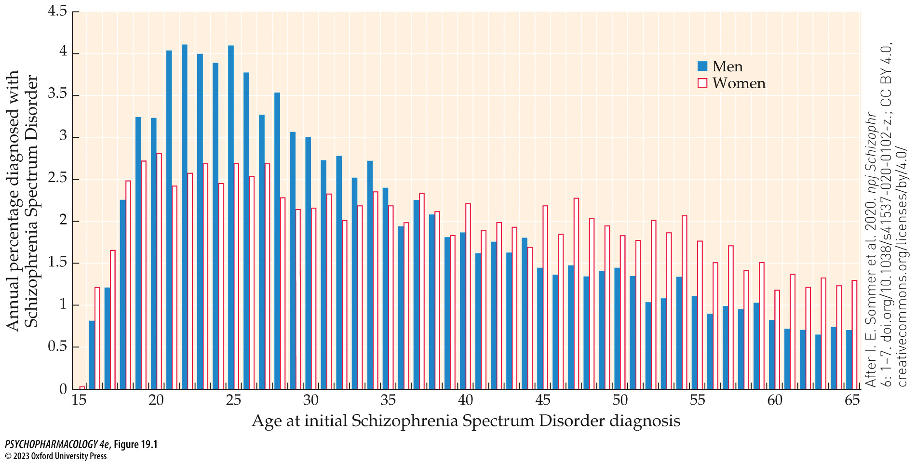
FIGURE 19.1 Sex differences in age at onset of schizophrenia
Notes:
FIGURE 19.1 Sex differences in age at onset of schizophrenia
Although both sexes show peak onset of symptoms between 16 and 25 years of age, this sample of 470 patients shows that more women than men experience their first episode after age 36, a difference that continues in every age bracket through old age. (After I. E. Sommer et al. 2020. npj Schizophr 6: 1–7. doi.org/10.1038/s41537-020-0102-z.; CC BY 4.0, creativecommons.org/licenses/by/4.0/)

Slide 9
Characteristics of Schizophrenia (2 of 4)
Schizophrenia is a heterogeneous disorder
DSM-5 defines schizophrenia with delusions, hallucinations, or disorganized thought
  Delusions of persecution and auditory hallucinations are common
  Grossly disorganized or abnormal motor behavior
  Language, particularly speech, often disorganized or incoherent
  Negative symptoms: reduced emotional expression, lack of volition, social withdrawal, apathy, cognitive defects
Notes:
Instructor Notes:

Slide 10
Characteristics of Schizophrenia (3 of 4)
Diagnosing schizophrenia can be challenging
No two individuals show the same pattern of symptoms
No single symptom occurs in every patient
Symptoms increase and decrease over time
Type of symptoms may change over time in one individual
Notes:
Instructor Notes:

Slide 11
Characteristics of Schizophrenia (4 of 4)
Diagnosing schizophrenia can be challenging
Positive symptoms dominant: delusions and hallucinations, disorganized speech and thinking, bizarre behavior
  Patients tend to be older at onset, respond well to antipsychotic medication
Negative symptoms dominant: reduced speech, flat affect, loss of motivation, social withdrawal
  Symptoms easily mistaken for other disorders (e.g., depression)
Cognitive symptoms: impaired working memory, executive function, etc.
  Negative and cognitive symptoms are resistant to current treatments
Notes:
Instructor Notes:

Slide 12
Review of Learning Objectives (1 of 4)
19.1.1 Describe the impacts of schizophrenia in terms of lifetime incidence and societal cost.
19.1.2 Describe how the symptoms of schizophrenia are framed in terms of positive, negative, and cognitive domains.

Slide 13
Etiology of Schizophrenia (1 of 13)
Abnormalities of brain structure and function occur in individuals with schizophrenia
Brain imaging shows cerebral atrophy and ventricle enlargement
Post-mortem studies: reduced brain volume due to small nerve cell somas, reduced dendritic trees and spine density
Hippocampal cells disorganized
Abnormal myelination and organization of white matter tracts reduces connectivity between brain regions
Notes:
Instructor Notes:

Slide 14
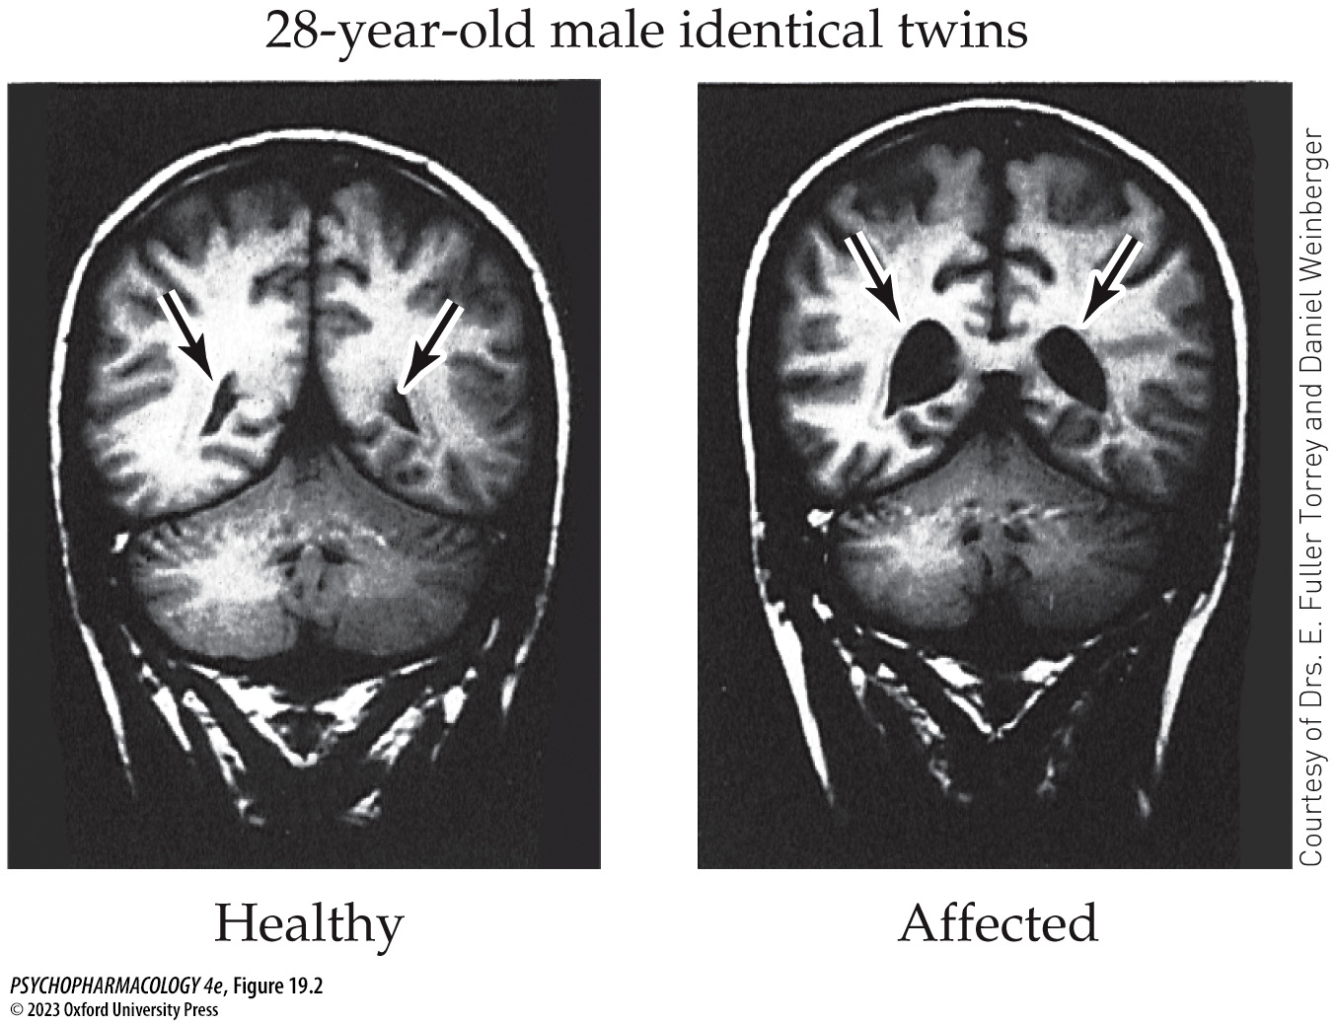
FIGURE 19.2 Brain images of twins not concordant for schizophrenia
Notes:
FIGURE 19.2 Brain images of twins not concordant for schizophrenia
The arrows in the figure point to the ventricles filled with cerebrospinal fluid. The healthy twin has normal-sized ventricles, and his schizophrenic twin has ventricles that are much enlarged.

Slide 15
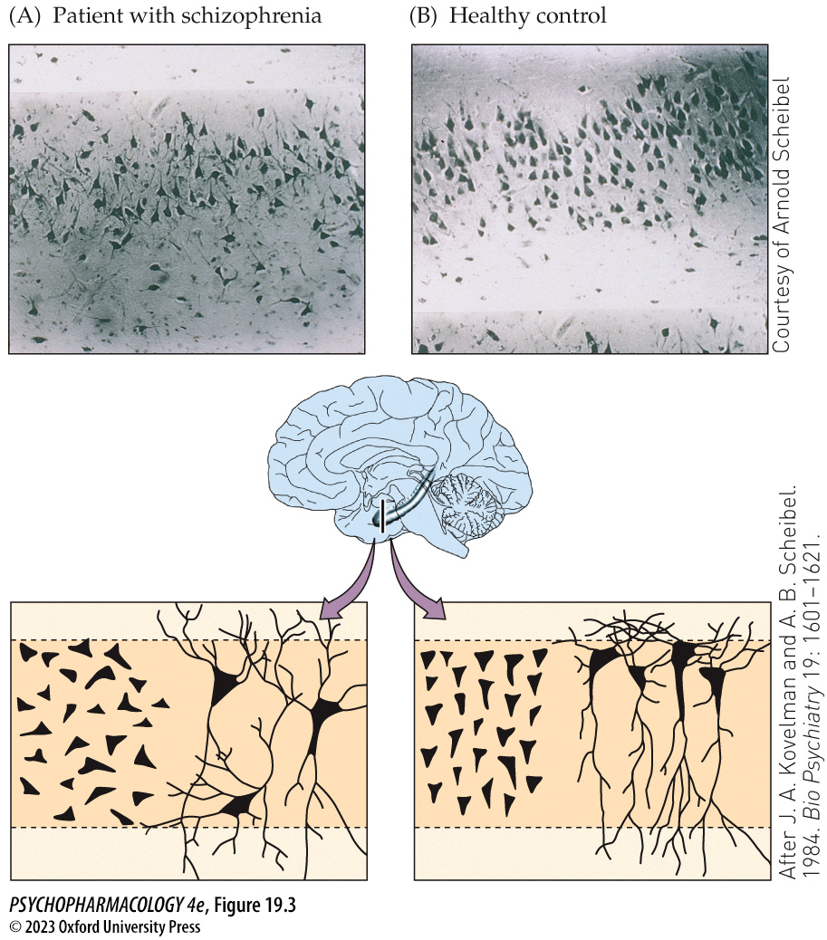
FIGURE 19.3 Disorganization of cells in the hippocampus
Notes:
FIGURE 19.3 Disorganization of cells in the hippocampus
Histological cross-sections of hippocampus showing the disorganized cells in the brain of a patient with schizophrenia (A) compared with the brain of a healthy control (B). Corresponding schematic diagrams show the haphazard arrangement of pyramidal cells in the hippocampus of patients with schizophrenia and the normal parallel organization in controls. (After J. A. Kovelman and A. B. Scheibel. 1984. Bio Psychiatry 19: 1601–1621.)

Slide 16
Etiology of Schizophrenia (2 of 13)
Abnormalities of brain structure and function occur in individuals with schizophrenia
Brain function abnormalities:
  Reduced function of PFC (hypofrontality) – PET scans show less blood flow to the frontal cortex when performing cognitive tasks
  Some brain areas show more activation, other brain areas show less, than in controls
Notes:
Instructor Notes:

Slide 17
Etiology of Schizophrenia (3 of 13)
Abnormalities of brain structure and function occur in individuals with schizophrenia
Association between immune dysfunction and schizophrenia:
  Blood levels of pro-inflammatory cytokines are elevated and anti-inflammatory cytokines are reduced; levels return to normal after successful antipsychotic drug treatment.
  Unclear whether cytokines cause, or are a result of, the symptoms
  Prenatal inflammation may cause abnormal neurodevelopment that increases the risk for schizophrenia.
Notes:
Instructor Notes:

Slide 18
Etiology of Schizophrenia (4 of 13)
Genetic, environmental, and developmental factors interact
A strong genetic component is shown by family, twin, and adoption studies; but identical twin concordance is not 100%
Identification of specific genes difficult – many genes at different loci are involved; 145 loci have been identified as likely sites
Notes:
Instructor Notes:
Technology such as DNA microarray and GWAS allow rapid screening of large quantities of genomic data.

Slide 19
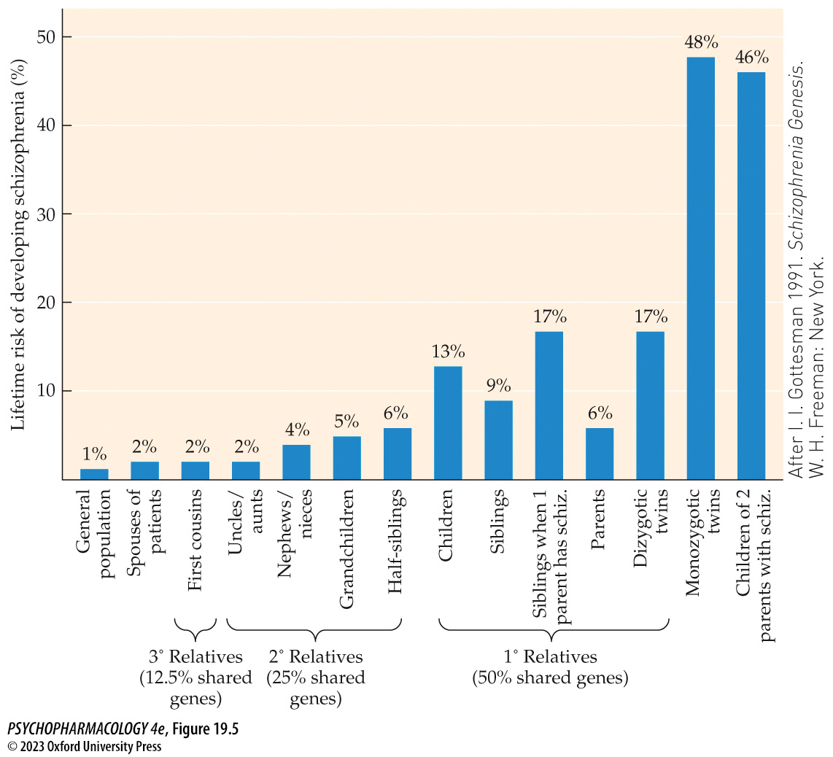
FIGURE 19.5 Lifetime risks of developing schizophrenia among relatives of an affected individual
Notes:
FIGURE 19.5 Lifetime risks of developing schizophrenia among relatives of an affected individual
Data are summarized from about 40 family and twin studies conducted between 1920 and 1987. Compared with a 1% risk of developing schizophrenia in the general population, second-degree relatives have an average risk of 4%, first-degree relatives have a 6% to 17% risk, monozygotic twins have a 48% risk, and children having two parents with schizophrenia have an average 47% risk. (After I. I. Gottesman 1991. Schizophrenia Genesis. W. H. Freeman: New York.)

Slide 20
Etiology of Schizophrenia (5 of 13)
BOX 19.1 THE CUTTING EDGE
Epigenetic Modifications and Risk for Schizophrenia
Early life stress produces epigenetic modifications that alter neurodevelopment
Reelin, a glycoprotein secreted by neurons, guides neuron positioning during fetal brain development
Reduced reelin expression is due to methylation of the RELN gene; could explain cell disorganization and morphological abnormalities in schizophrenic brains
  Supported by research with animal models
Notes:
Instructor Notes:

Slide 21
Etiology of Schizophrenia (6 of 13)
Genetic, environmental, and developmental factors interact
Mutations of the DISC1 gene may contribute to risk of schizophrenia
It codes for proteins essential in neural development and can be disrupted by a chromosome translocation
Various DISC1 polymorphisms are also implicated in other psychiatric disorders
Notes:
Instructor Notes:

Slide 22
Etiology of Schizophrenia (7 of 13)
Genetic, environmental, and developmental factors interact
Genetic vulnerability may increase probability that events during perinatal brain development will contribute to risk
  Exposure to viral infections and ensuing inflammatory response – cytokines can affect neurogenesis
  Other prenatal assaults can also cause inflammation
  Behavioral abnormalities apparent in young children who later develop schizophrenia suggest early developmental errors
  Developmental errors during adolescence cause twice the cortical cell loss compared with that seen in healthy teens
Notes:
Instructor Notes:

Slide 23
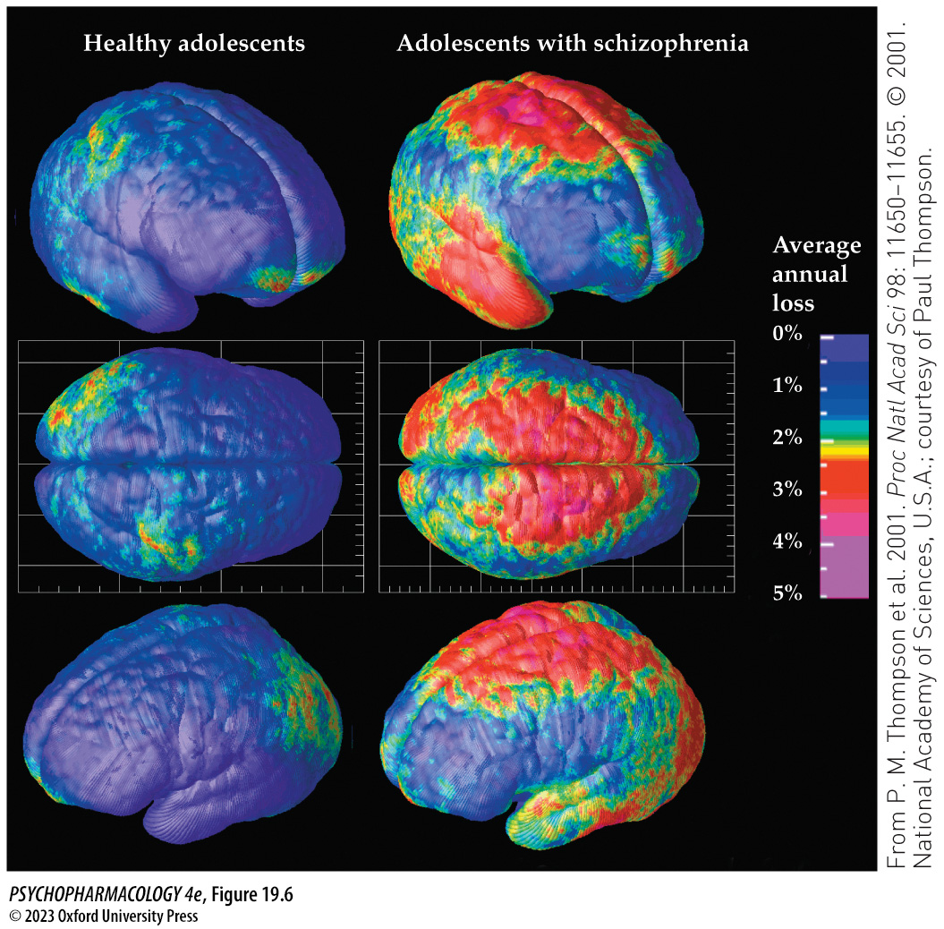
FIGURE 19.6 Cortical gray matter loss
Notes:
FIGURE 19.6 Cortical gray matter loss
Three-dimensional maps of brain changes show the average annual rate of loss of cortical gray matter in healthy adolescents (left) and in adolescents with schizophrenia (right).

Slide 24
Etiology of Schizophrenia (8 of 13)
Genetic, environmental, and developmental factors interact
The “two-hit” model of schizophrenia development:
  Perinatal events in a genetically vulnerable individual cause altered brain development
  In adolescence neurodevelopmental errors plus environmental events produce diagnosable symptoms
Notes:
Instructor Notes:

Slide 25
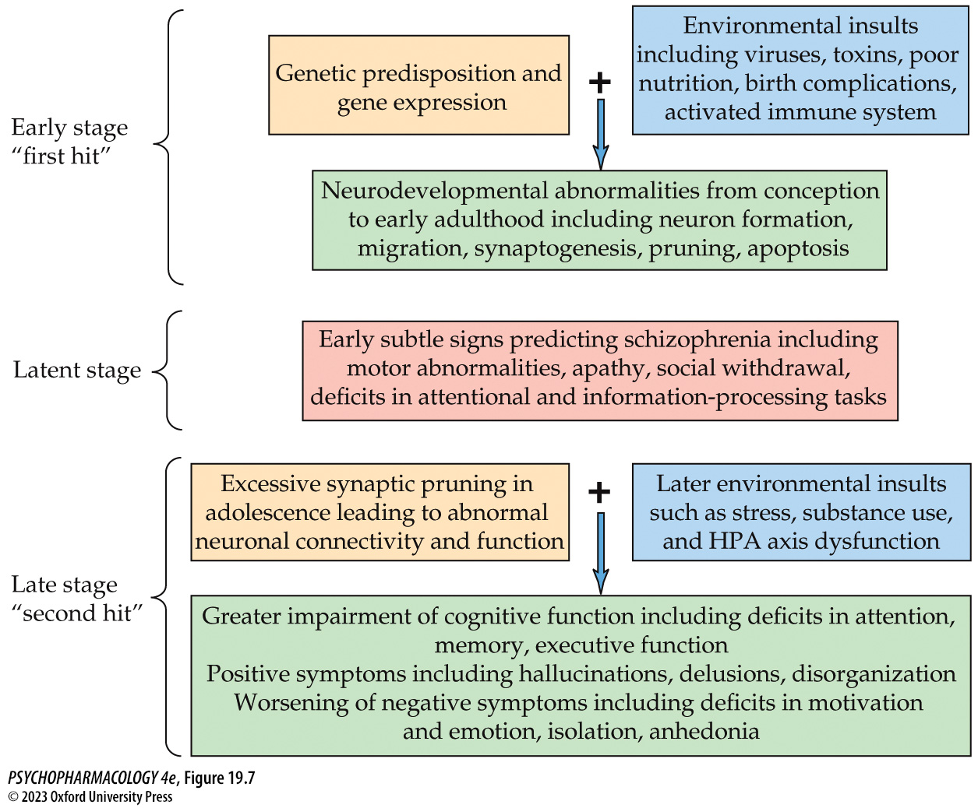
FIGURE 19.7 Etiology of schizophrenia
Notes:
FIGURE 19.7 Etiology of schizophrenia
This schematic diagram shows the importance of the interaction of genes and environmental factors in the development of schizophrenia, based on material presented in the text. Genes and environment interact to cause abnormal development of the nervous system. The neurodevelop­mental abnormalities, such as errors in connectivity, make the individual susceptible to later environmental events at adolescence, which exacerbates the cognitive deficits and negative symptoms and elicits the positive symptoms leading to diagnosis.

Slide 26
Etiology of Schizophrenia (9 of 13)
Preclinical models of schizophrenia
Animal models focus on one aspect of the disorder to experimentally induce similar changes in animal behavior
Potential new drugs: models often depend on neurochemically induced behaviors known to respond to currently useful drugs.
  Often fails to identify novel drugs
CNS stimulants produce symptoms similar to schizophrenia
Notes:
Instructor Notes:

Slide 27
Etiology of Schizophrenia (10 of 13)
Preclinical models of schizophrenia
Amphetamine-induced stereotypy: the compulsive repetitions of meaningless behavior seen in schizophrenia
Hypoglutamate model: NMDA receptor antagonists PCP and ketamine produce behaviors similar to symptoms of schizophrenia
Vacuous chewing movements test: mouth and facial dyskinesias similar to the tardive dyskinesia that occurs in some patients
Attentional set-shifting task: rodent version of the WCST
Prepulse inhibition of startle (PPI): models used to study sensory-filtering deficits
Neonatal ventral hippocampal lesion model (NVHL)
Notes:
Instructor Notes:

Slide 28
Etiology of Schizophrenia (11 of 13)
BOX 19.2 PHARMACOLOGY IN ACTION
The Prenatal Inflammation Model of Schizophrenia
Rodent models using maternal immune activation:
  The inflammatory agent polyI:C mimics the acute response to viral infection
  Lipopolysaccharide, a bacterial endotoxin
Levels of pro-inflammatory cytokines are elevated in the fetal brain, placenta, and amniotic fluid
The agents produce brain structural, neurochemical, cognitive, and behavioral outcomes that resemble components of schizophrenia
Notes:
Instructor Notes:

Slide 29
Etiology of Schizophrenia (12 of 13)
Preclinical models of schizophrenia
Genetic models: modifications of schizophrenia susceptibility genes
DA reuptake transporter knockout mice show hyperactivity, deficits in PPI, stereotyped movements, and spatial learning impairments
Newer models also manipulate environmental factors, prenatal inflammation, postnatal stress, vitamin D deficiency, exposure to drugs of abuse.
Notes:
Instructor Notes:

Slide 30
Etiology of Schizophrenia (13 of 13)
CLICKER QUESTION 1
Which of the following is not an abnormality found in the brain of schizophrenic patients?
Cerebral atrophy
Increased connectivity between brain regions
Disorganized hippocampal cells
Ventricle enlargement
Notes:
Instructor Notes:
Correct answer: b

Slide 31
Review of Learning Objectives (2 of 4)
19.2.1 Explain how irregularities in brain structure and function, coupled with neuroinflammation, combine to suggest altered developmental processes in schizophrenia.
19.2.2 Describe the role of genetics in the etiology of schizophrenia.
19.2.3 Explain how genetic risk may combine with perinatal complications to contribute to elevated risk of schizophrenia.
19.2.4 Describe the main categories of preclinical animal models for schizophrenia, including drug-induced, prenatal inflammation, and genetic models.

Slide 32
Neurochemical Models of Schizophrenia (1 of 5)
Abnormal DA function contributes to schizophrenic symptoms
Dopamine hypothesis of schizophrenia: positive symptoms are caused by excessive mesolimbic DA activity
  Amphetamine produces positive symptoms in healthy individuals that can be reversed by DA antagonists
  Amphetamines make symptoms worse in patients with schizophrenia
  Strong correlation between D₂ receptor blockade and reduction of symptoms
  Schizophrenic individuals show exaggerated DA release after amphetamine challenge as well as in basal conditions
  Some evidence for increased D₂ receptors in schizophrenia
Notes:
Instructor Notes:

Slide 33
Neurochemical Models of Schizophrenia (2 of 5)
Abnormal DA function contributes to schizophrenic symptoms
DA imbalance hypothesis: symptoms are due to reduced DA function in mesocortical neurons along with excess DA function in mesolimbic neurons
  Negative symptoms and impaired thinking explained by impaired PFC function (low mesocortical activity)
  Positive symptoms improved by reducing DA function in mesolimbic neurons
Notes:
Instructor Notes:

Slide 34
Neurochemical Models of Schizophrenia (3 of 5)
The neurodevelopmental model integrates anatomical and neurochemical evidence
Negative and cognitive symptoms are associated with reduced frontal lobe function
Excessive mesolimbic DA activity following early mesocortical cell loss can explain the positive symptoms
Early mesocortical cell loss due to genetics or environmental events that alter brain development are followed by loss of inhibitory control of mesolimbic cells and onset of positive symptoms
Notes:
Instructor Notes:

Slide 35
Neurochemical Models of Schizophrenia (4 of 5)
Glutamate and other neurotransmitters contribute to symptoms
Inadequate glutamate may explain the apparent increase in mesolimbic DA and decrease in PFC.
Descending glutamatergic neurons influence both mesocortical and mesolimbic DA pathways.
Evidence for the importance of NMDA receptors comes from challenge studies, rodent studies, receptor subunit studies, and genetics – suggesting that NMDA hypofunction is central to schizophrenia
Notes:
Instructor Notes:

Slide 36
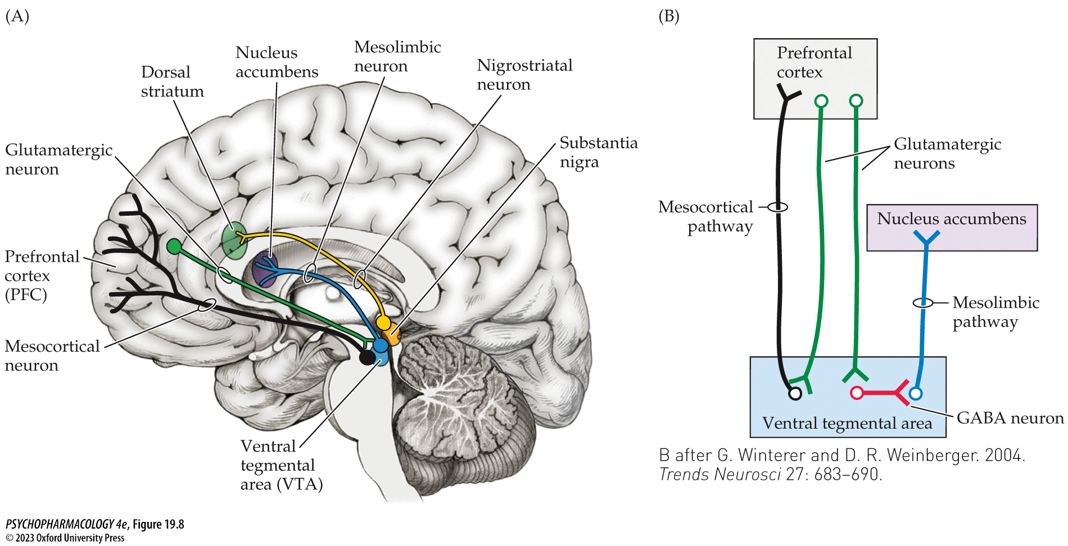
FIGURE 19.8 Hypoglutamate hypothesis of schizophrenia
Notes:
FIGURE 19.8 Hypoglutamate hypothesis of schizophrenia
(A) Midsagittal view showing nigrostriatal (yellow), mesolimbic (blue), and mesocortical (black) dopaminergic neurons as well as a descending glutamatergic neuron (green) originating in the prefrontal cortex (PFC). (B) Since descending glutama­tergic neurons (green) excite mesocortical DA neurons (black), poor glutamate signaling would produce low DA release in PFC, exacerbating negative and cognitive symptoms. Other glutamatergic neurons (green) excite inhibitory GABA neurons (red) that subsequently inhibit the dopaminergic mesolimbic pathway. (These tiny neurons within the VTA could not be depicted in part A.) In this case, low glutamate signaling would fail to inhibit mesolimbic firing, leading to excess DA release in the nucleus accumbens and positive symptoms. (B after G. Winterer and D. R. Weinberger. 2004. Trends Neurosci 27: 683–690.)

Slide 37
Neurochemical Models of Schizophrenia (5 of 5)
CLICKER QUESTION 2
Which model of schizophrenia was suggested by the fact that amphetamine users experience psychotic symptoms that could be reversed by DA antagonists?
Dopamine hypothesis
DA imbalance hypothesis
Neurodevelopomental model
Notes:
Correct answer: a

Slide 38
Review of Learning Objectives (3 of 4)
19.3.1 Describe the evidence in support of the dopamine hypothesis of schizophrenia.
19.3.2 Explain the respective roles of abnormal mesolimbic and mesocortical dopamine neurotransmission in the positive and negative symptoms of schizophrenia.
19.3.3 Describe the evidence in support of the role for altered glutamate neurotransmission in schizophrenia.
19.3.4 Explain how glutamate and dopamine systems are thought to interact, thereby producing the symptoms of schizophrenia.

Slide 39
Classic Neuroleptics and Atypical Antipsychotics (1 of 16)
None of the drugs are consistently more effective than the others; individuals may respond better to one drug than to another
Classic: phenothiazines and butyrophenones
Second generation: clozapine, risperidone, and aripiprazole; produce fewer side effects
Notes:
Instructor Notes:
Neuroleptics: older term for antipsychotic drugs

Slide 40
Classic Neuroleptics and Atypical Antipsychotics (2 of 16)
Phenothiazines and butyrophenones are classic neuroleptics
Chlorpromazine was the first phenothiazine; has had many modifications
Molecular modifications affect ability of drug to bind to specific receptors and alter their potency and side effects
Notes:
Instructor Notes:

Slide 41
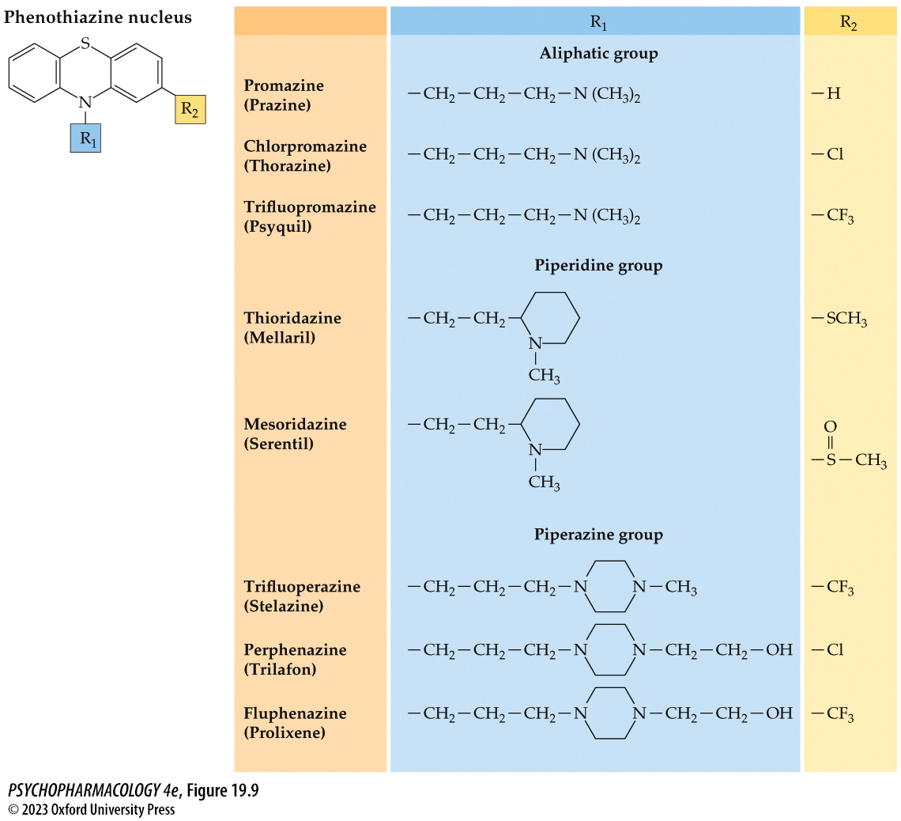
FIGURE 19.9 Phenothiazine nucleus and related compounds
Notes:
FIGURE 19.9 Phenothiazine nucleus and related compounds
Minor molecular modifications determine the three major subgroups of phenothiazines and change drug potency, pharmacological activity, and side effects.

Slide 42
Classic Neuroleptics and Atypical Antipsychotics (3 of 16)
Phenothiazines and butyrophenones are classic neuroleptics
Effectiveness:
  Law of thirds
  Antipsychotic drugs are prescribed as maintenance therapy to prevent relapse
  Unpleasant side effects cause many patients to stop treatment
  Psychotherapy and group therapy are important additions
Notes:
Instructor Notes:

Slide 43
Classic Neuroleptics and Atypical Antipsychotics (4 of 16)
Dopamine receptor antagonism is responsible for antipsychotic action
There is a strong correlation between drug binding affinity and dose required to achieve clinical effectiveness
Antipsychotic drugs bind to other neurotransmitter receptors, but no clear relationship to effectiveness
Correlation with D₂ receptor binding clearly establishes the mechanism
Notes:
Instructor Notes:

Slide 44
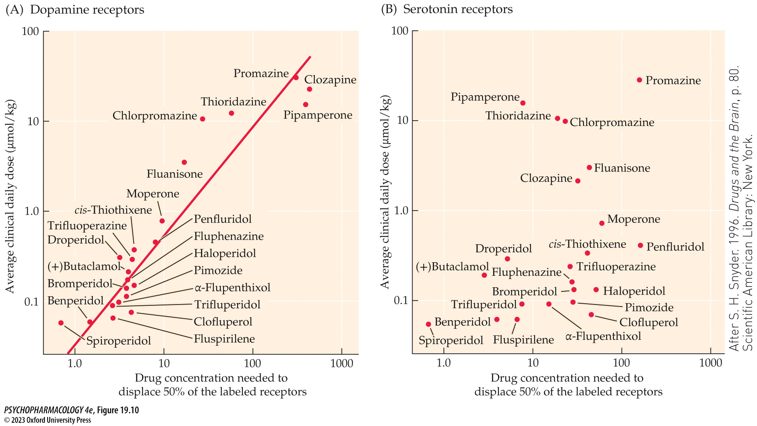
FIGURE 19.10 Correlation between antipsychotic drug binding to neurotransmitter receptors and clinical effectiveness
Notes:
FIGURE 19.10 Correlation between antipsychotic drug binding to neurotransmitter receptors and clinical effectiveness
The receptor binding studies were accomplished by first labeling the receptors with an appropriate radioactive ligand for each neurotransmitter. The antipsychotic drug was added in increasing concentrations until it competed successfully for half of the labeled sites. That value (K_{i}) is plotted along the x-axis, and the corresponding average clinical daily dose for that drug is plotted on the y-axis. A clear positive correlation is found for dopamine receptor binding (A), but serotonin receptor binding shows no apparent correlation with effectiveness (B). Further experiments found no correlation between clinical effects and binding to either α-adrenergic or histamine receptors. (After S. H. Snyder. 1996. Drugs and the Brain, p. 80. Scientific American Library: New York.)

Slide 45
Classic Neuroleptics and Atypical Antipsychotics (5 of 16)
Dopamine receptor antagonism is responsible for antipsychotic action
D₂ receptors are located in the basal ganglia, NAcc, amygdala, hippocampus, cerebral cortex
Blockade of D₂ autoreceptors causes initial increase in DA neuron firing and increased turnover of DA, followed by gradual decrease as autoreceptors up-regulate
Depolarization block may contribute to the decrease in turnover
Notes:
Instructor Notes:

Slide 46
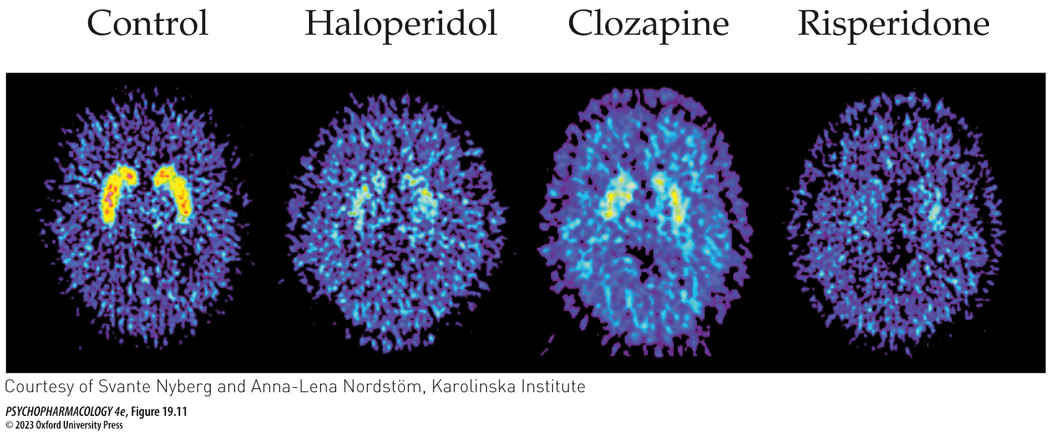
FIGURE 19.11 D₂ receptor occupancy by antipsychotic drugs
Notes:
FIGURE 19.11 D₂ receptor occupancy by antipsychotic drugs
PET scans of a healthy, untreated male (control) and three patients with schizophrenia treated with the classic neuroleptic haloperidol or with an atypical antipsychotic drug (clozapine or risperidone). In all individuals, striatal D₂ receptors were labeled with [¹¹C]raclopride. The scans show that the radioactive label of striatal D₂ receptors was displaced almost completely by haloperidol and risperidone binding but less effectively by clozapine. These and other differences in receptor antagonism are thought to be responsible for the ability of the clozapine-like neuroleptics to reduce symptoms without producing serious motor side effects.

Slide 47
Classic Neuroleptics and Atypical Antipsychotics (6 of 16)
Dopamine receptor antagonism is responsible for antipsychotic action
Normally, DA inhibits prolactin release from the pituitary
By blocking D₂ receptors in the pituitary gland, antipsychotics stimulate secretion of prolactin, leading to lactation and breast enlargement
Measuring serum prolactin levels provides an easy measure of D₂ receptor function in the CNS
Notes:
Instructor Notes:

Slide 48
Classic Neuroleptics and Atypical Antipsychotics (7 of 16)
Side effects are directly related to neurochemical action
Four DA pathways in the brain are important for understanding drug action:
  Mesolimbic pathway—affects positive symptoms
  Mesocortical pathway—cognitive and negative symptoms
  Nigrostriatal pathway—motor side effects
  Tuberohypophyseal pathway—regulates pituitary hormone secretion; neuroendocrine effects
Notes:
Instructor Notes:

Slide 49
Classic Neuroleptics and Atypical Antipsychotics (8 of 16)
Side effects are directly related to neurochemical action
Parkinsonian symptoms involve the extrapyramidal motor system (EPS)
Some antipsychotics have anticholinergic action, such as thioridazine
Alternatively, antipsychotic drugs are combined with an anticholinergic drug such as benztropine (Cogentin)
Notes:
Instructor Notes:

Slide 50
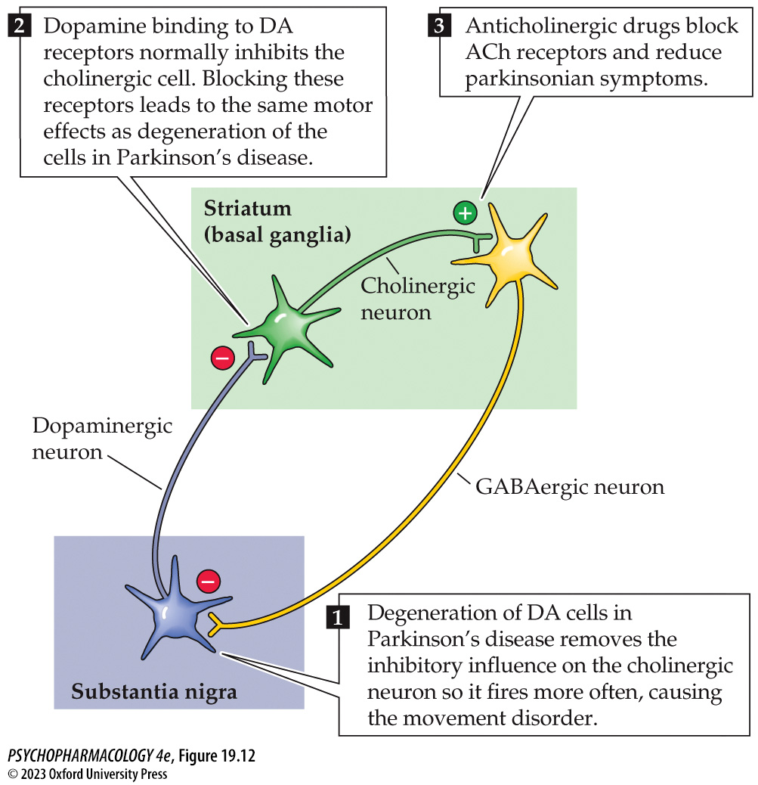
FIGURE 19.12 Schematic diagram showing the neurotransmitters involved in parkinsonian symptoms (1)
Notes:
FIGURE 19.12 Schematic diagram showing the neurotransmitters involved in parkinsonian symptoms
Parkinson’s disease is caused by degeneration of the nigrostriatal dopaminergic neurons, which originate in the substantia nigra. The reduced dopaminergic cell function causes a loss of inhibitory control of the cholinergic cells in the striatum, so the cholinergic cells fire at higher rates. Drug-induced parkinsonian symptoms follow DA receptor blockade in the striatum and subsequent excess acetylcholine activity, which is functionally similar to the loss of dopaminergic cells in Parkinson’s disease. Anticholinergic drugs reduce the symptoms of Parkinson’s disease and the side effects of antipsychotic drug treatment.

Slide 51
Classic Neuroleptics and Atypical Antipsychotics (9 of 16)
Side effects are directly related to neurochemical action
Incidence of tardive dyskinesia (TD) increases with duration of treatment
VMAT2 inhibitors have been approved for treatment of TD that selectively interfere with ability of dopamine neurons to package DA into vesicles, reducing amount of DA that can be released
Notes:
Instructor Notes:
VMAT2 inhibitors: valbenazine and deutetrabenazine

Slide 52
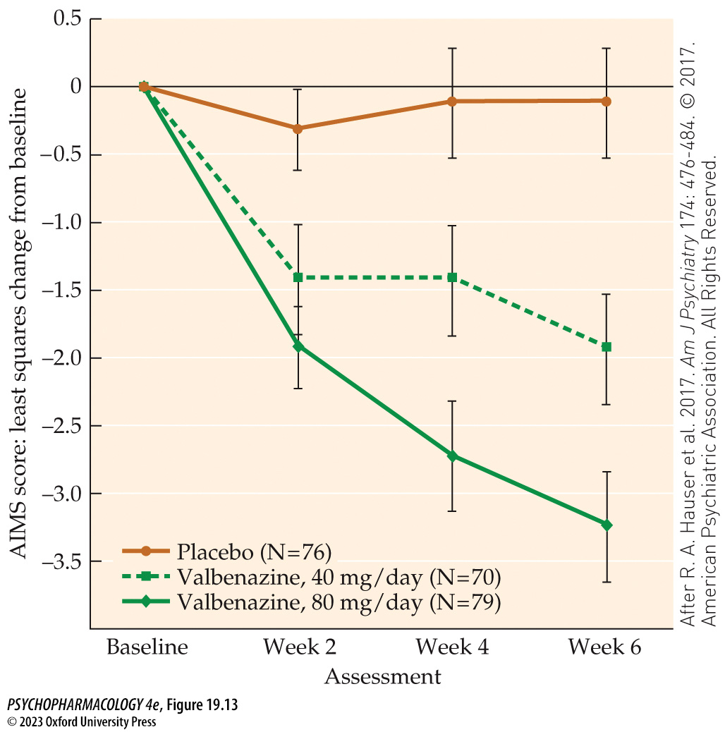
FIGURE 19.13 Effect of VMAT2 inhibition on tardive dyskinesia
Notes:
FIGURE 19.13 Effect of VMAT2 inhibition on tardive dyskinesia
Results from a Phase 3 clinical trial showed that ongoing treatment with the VMAT2 inhibitor valbenazine significantly decreased abnormal movements associated with TD, as measured by the Abnormal Involuntary Movement Scale (AIMS). This effect was dose-dependent, with the 80-mg dose showing the largest effect. (After R. A. Hauser et al. 2017. Am J Psychiatry 174: 476-484. © 2017. American Psychiatric Association. All Rights Reserved.)

Slide 53
Classic Neuroleptics and Atypical Antipsychotics (10 of 16)
Side effects are directly related to neurochemical action
Blockade of receptors in the DA pathway that regulate pituitary function produces neuroendocrine effects:
  Decreased sex drive, no menstruation, increased prolactin, inhibition of growth hormone, weight gain, inability to regulate body temperature
Neuroleptic malignant syndrome (NMS): life-threatening
  Fever, rigidity, altered consciousness, and ANS instability (including rapid heart rate and fluctuations in blood pressure).
Notes:
Instructor Notes:

Slide 54
Classic Neuroleptics and Atypical Antipsychotics (11 of 16)
Atypical antipsychotics are distinctive in several ways
Atypical or second generation antipsychotics reduce positive symptoms without causing significant EPS and other side effects
  Selective D₂ receptor antagonists
  DA partial receptor agonists (DA system stabilizers)
  Broad-spectrum antipsychotics block other receptor types in addition to D₂ receptors
Notes:
Instructor Notes:

Slide 55
Classic Neuroleptics and Atypical Antipsychotics (12 of 16)
Atypical antipsychotics are distinctive in several ways
Clozapine has weak affinities for D₁ and D₂ and strong affinities for serotonergic, muscarinic, histaminergic, and D₄ receptors
  Reduces some of negative and cognitive symptoms but has many side effects because of its action on multiple receptors
Newer atypical drugs bind with varying affinities for multiple receptor subtypes
  Side effects can be predicted on the basis of receptor affinity
Notes:
Instructor Notes:
Atypical drugs: include risperidone, olanzapine, quetiapine, ziprasidone, sertindole

Slide 56
Classic Neuroleptics and Atypical Antipsychotics (13 of 16)
Practical clinical trials help clinicians make decisions about drugs
A practical clinical trial (CATIE) using 1500 patients (2001 – 2004):
  Atypical drugs were no more effective than the classical drug perphenazine in reducing positive, negative, or cognitive symptoms
  Occurrence of EPS was similar for all drugs tested
Notes:
Instructor Notes:

Slide 57
Classic Neuroleptics and Atypical Antipsychotics (14 of 16)
There are renewed efforts to treat the cognitive symptoms
Potential new approaches to improving cognitive impairments:
  Enhancing ACh with subtype-selective nicotinic agonists or positive allosteric modulators (PAMs)
  Selectively enhance D₁ receptor signaling in PFC with D₁ agonists
  Inhibit the enzyme (COMT) that degrades DA in the synapse
  Glycine agonists; glycine transporter inhibitors
  Anti-inflammatory agents
Notes:
Instructor Notes:

Slide 58
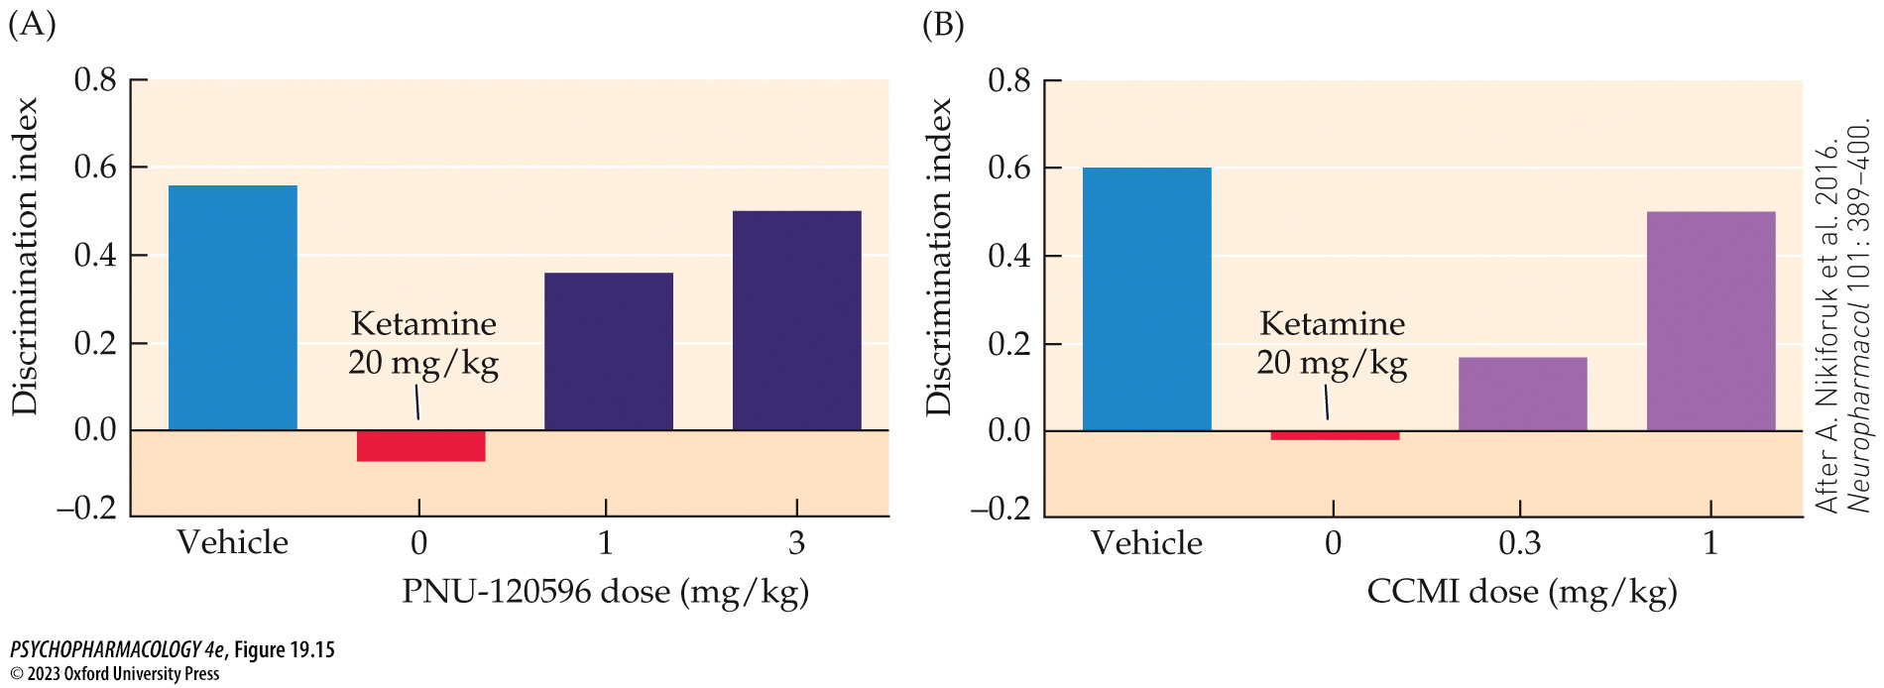
FIGURE 19.15 Effects of PAMs on novel object recognition
Notes:
FIGURE 19.15 Effects of PAMs on novel object recognition
The discrimination index represents the animals’ ability to remember an object that was presented on day 1 and to spend more time investigating a novel object when both the old object and the new object are presented on day 2. Both bar graphs show that 20 mg/kg of ketamine dramatically reduced the cognitive function in the absence of either PAM. As PAM (PNU-120596 and CCMI) dosages increased, the ability to discriminate increased to approximately control levels. (After A. Nikiforuk et al. 2016. Neuropharmacol 101: 389–400.)

Slide 59
Classic Neuroleptics and Atypical Antipsychotics (15 of 16)
There are renewed efforts to treat the cognitive symptoms
NAVIGATE: a comprehensive multimodal, multidisciplinary, team-based approach
Includes education, social support, one-on-one therapy, and individualized, low-dose medications
Family and patient are included in decision making
Notes:
Instructor Notes:

Slide 60
Classic Neuroleptics and Atypical Antipsychotics (16 of 16)
CLICKER QUESTION 3
The effectiveness of antipsychotic drugs is due to
blockage of many different receptor types.
anticholinergic action.
dopamine receptor antagonism.
Notes:
Instructor Notes:
Correct answer: c

Slide 61
Review of Learning Objectives (4 of 4)
19.4.1 Identify the common neural mechanism that likely accounts for the clinical efficacy of antipsychotics in reducing the positive symptoms of schizophrenia.
19.4.2 Describe the neural basis for the motor (parkinsonism, tardive dyskinesia) and neuroendocrine side effects of most antipsychotic drugs.
19.4.3 Explain how first- and second-generation antipsychotics differ in terms of mechanism of action, therapeutic efficacy, and side effects.
19.4.4 Identify dopaminergic and non-dopaminergic strategies for treating the cognitive symptoms of schizophrenia.

